Slide 1

Democracy
Yr 7 Civics and Citizenship

Slide 2
Lesson Aims
To understand the concept of democracy
Identify some democratic values
Describe two examples of democratic values- voting and representative government
Conduct a fair and democratic voting process
Demonstrate how representative government works

Slide 3

Group Activity – groups of 6-8
The school has decided to take you on a special camp (once COVID-19 restrictions are over). You are able to choose where the camp will be held and all of the activities that you do.
Rules:
  The camp can be anywhere in Australia (the school has just received a lot of money for flights!).
  It has to be 5 days
  You can plan any activities that are safe and fit within the school rules
  You only have three minutes to reach a decision. Your teacher will NOT help you with your decisions.
Notes:
Teacher to sit at back of room with a notepad and write down observations about how decisions are made. Although it may be tempting to intervene if things get loud/raucous, it’s important that you let the scene play out without teacher intervention (within reason). Keep time (3 minutes). Observations might include things like: • Students sat in silence for the first 20 seconds • Student X leapt up in front of the class to take charge immediately • Student y shouted constantly • Students A, B, C started talking as a group and didn’t listen to others • Some students said nothing and their input was not considered • Some students dominated the discussion and shouted their ideas over the top • Some students became uninterested and started doing something else When the time is up, give some constructive feedback to the class about what you observed. Ask students to think about whether they thought this was a very fair group decision‑making process.

Slide 4
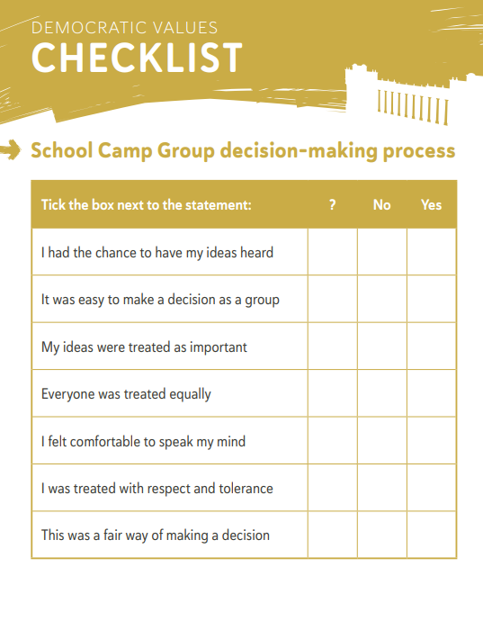
Fairness
Feedback- what I observed
Complete the checklist- share with a partner. Were there any similarities/differences in your answers?
Do you think your group was fair with the decision making process? Why/why not?
What would happen if there were 50 people making this decision? What about 100? Or 23 million?

Slide 5
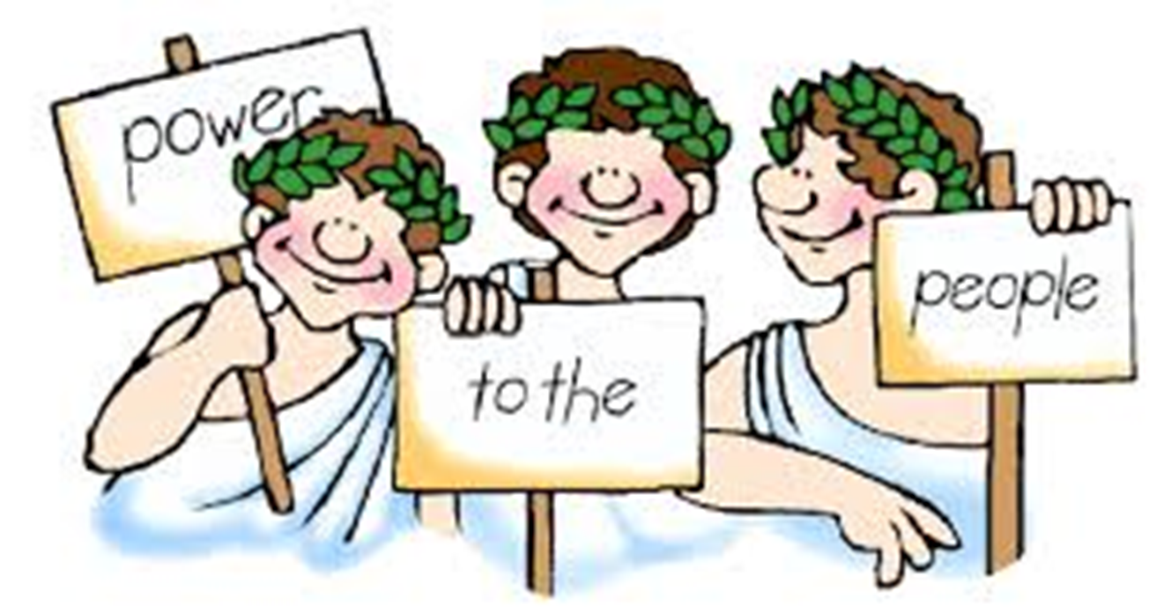
Key Concept: Democracy
Definition: A system of government where the people have the power to determine how they will be ruled, and elect their government to make and implement laws on their behalf.
It helps society make decisions that are fair.
http://www.abc.net.au/btn/classroom/what-is-democracy/10524786

Slide 6
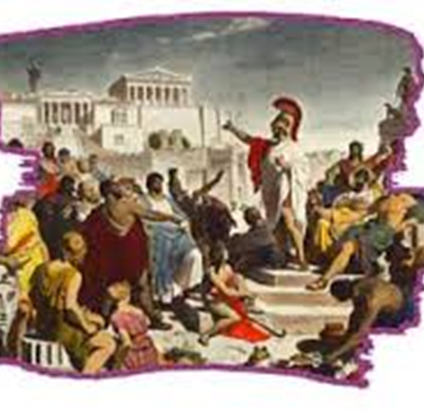
Where does Democracy come from?
Ancient Greece
It comes from two Greek words: Demos (all citizens living within a particular state) and Kratos (power). It means ‘people power’.
Citizens would meet at the market place to discuss important issues and vote on matters, such as going to war.
Each citizen had an equal right to participate (although only free men could become citizens.

Slide 7
Voting
In order to make sure that group decisions are made fairly, we vote.
Have you had the chance to vote for something in the past? What was it?

Slide 8
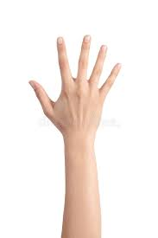
Let’s take a vote:
Put your hand up if you agree:
Cats are better than dogs
Sweet food is better than savoury food
Football is better than soccer
Going to school is important
Eagles are better than the Dockers

Slide 9
Now let’s take a vote, but in secret:
After you have read the statement, write YES or NO on your piece of paper. You CANNOT tell anyone your response.
We will then count the results and put them on the board.
Statements:
-This school is one of the best schools in Western Australia
-Coming to school makes me feel happy
-

Slide 10
Let’s compare the two types of voting:
Open Vote
What are some advantages of the open vote?
What are some disadvantages of the open vote?
Secret Ballot
What are some advantages of the secret ballot?
What are some disadvantages of the open ballot?
How was voting a more democratic process than the group decision-making at the start of the class? Do you think that it’s practical to ask EVERYONE to take a vote every time a decision needs to be made in Australia?
Notes:
Potential responses:
What are some of the advantages of the open vote? – Fast – Efficient – Gives a quick snapshot of a group’s main opinion • What are some of the disadvantages of the open vote? – People may be influenced by others – People may feel pressure to follow other people’s opinions – It requires accurate counting and record‑keeping – If there were lots more people, it would take too long • What are some of the advantages of the secret ballot? – It gives people confidence to vote without pressure – Relatively fast – Gives a good overview of a group’s main opinion • What are some of the disadvantages of the secret ballot? – It takes longer than an open vote – People could perhaps tamper with the votes behind the scenes (this happens in many parts of the world – good to discuss) – If there were more people, it would take a long time to add up/tally all the responses.

Slide 11
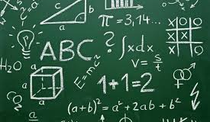
Group Activity- Representative Democracy
Groups of 3 or 5
You need to have a discussion (making sure everyone in the group is heard) about the following issues:
  What is more important: hospitals or the police?
  What is more important: Maths or English?

Slide 12
Group Activity- Representative Democracy
Select one person to ‘represent’ your group.
Vote on the statements from the previous slide. Record the results on the board.
Was this a fair process? How well did the representatives represent their group’s feelings?

Slide 13
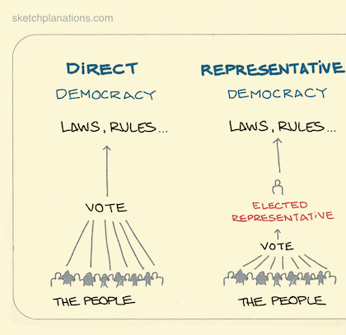
Direct Democracy vs Representative Democracy
Direct democracy:
  In Ancient Greece, every citizen could vote on rules and laws because the population was so small.
Representative democracy:
  In modern countries, the population is too big for this to happen. We elect representatives to express our political views.
  These representatives go to parliament where they discuss and vote on key issues of the day

Slide 14

School Camp– Revisited
How could you make your group decision making process from the beginning of the lesson more democratic?
-Group discussion, everyone gets a turn
-You may do an open or closed ballot vote (direct democracy)
-You may elect a representative

Slide 15
Democracy – Key Features
Democracy
Although there are many different types of democracies, the main features of a democracy include the following:
Free and fair elections. Each person who votes has the same power as any other.
Votes conducted by secret ballot.
Decisions approved by a majority vote before they are put into place, though minority has the right to express their opinion.
Many political parties to represent the varied interests and difference of opinion.

Slide 16
Today’s lesson- reflection
What did you learn about group decision making today?
What did you learn about ‘democracy’ today?
What does ‘voting’ mean? What does ‘Representative government’ mean? What are some of the advantages of these processes?

Slide 17
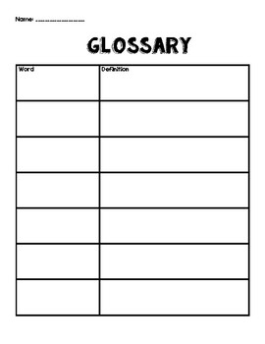
Questions
Comprehension:
In your own words, what is democracy? Add this to your word-wall or glossary.
The word ‘democracy’ comes from which two words?
What do the representatives in parliament do?
In Australia, we have something called a _______ democracy.
Thinking questions:
How is our current system of democracy different from the one in Ancient Greece?
What are some other forms of government?
Why is it important for citizens to participate in a democracy?

Slide 18
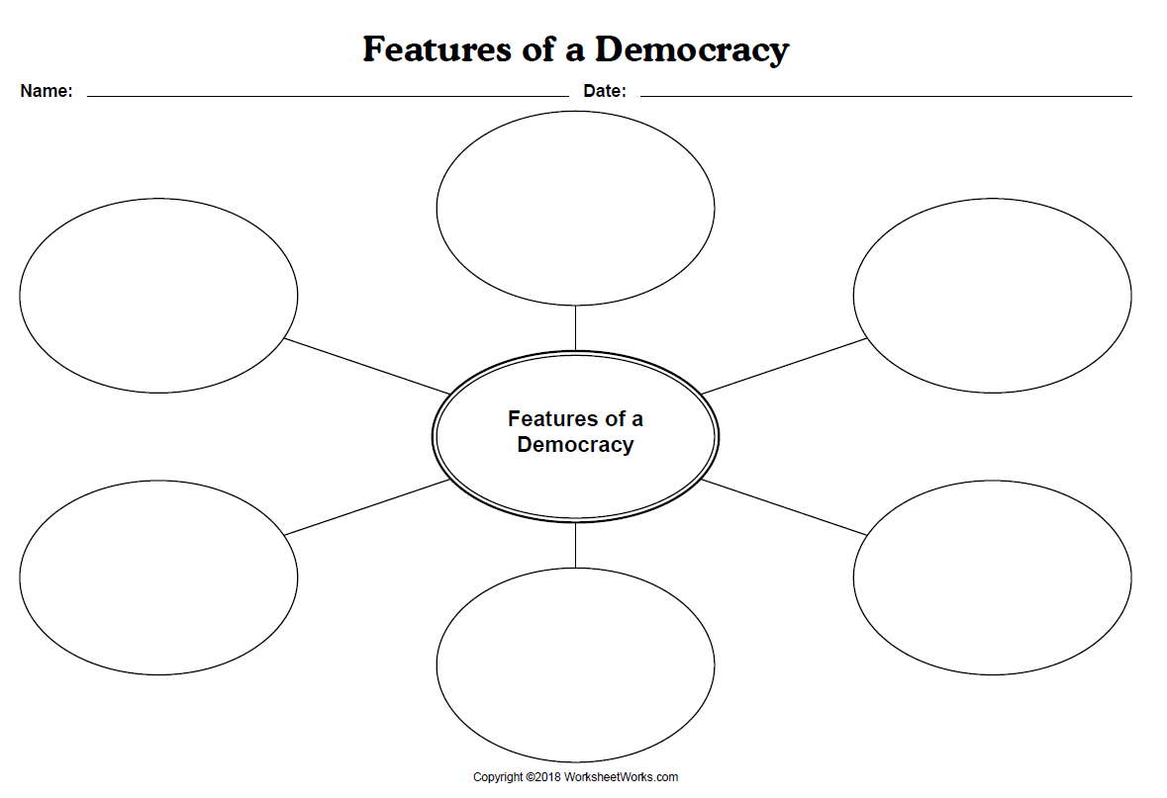
Using the information from the previous slides complete the Star Diagram – Features of a Democracy

